Slide 1
Michael Allen Sprint #5 Review
Exploratory & Analysis of
US Contagious Diseases

Slide 2
Game Plan
Take a Somewhat Cleaned CSV “End of Course Survey” file and “Read” into R
(In reality actually working with the original dirty data)
2. Then Write a Script to:
Change the Categorical Data to Specific Numerical Data
Perform Mean Calculations Per Question (Column)
Perform Standard Deviation Calculations Per Question (Column)
View Just the Results in R
Output to a PDF file a Bar Graph of the Means Per Question
Output to a PDF file a Bar Graph of the Standard Deviation Per Question
Write All of the Analysis Data back to a CSV file

Slide 3
Create a Script in R to Perform Statistical Analysis

Slide 4



Viewing the Highest Sick Percentage after Calculation

Slide 5
Parameters of the Mean (MPLS) Graph

Slide 6


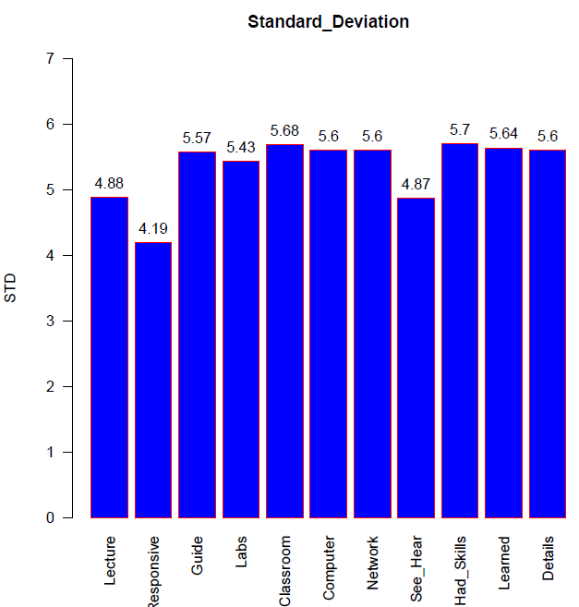
Parameters of the Standard Deviation Graph

Slide 7
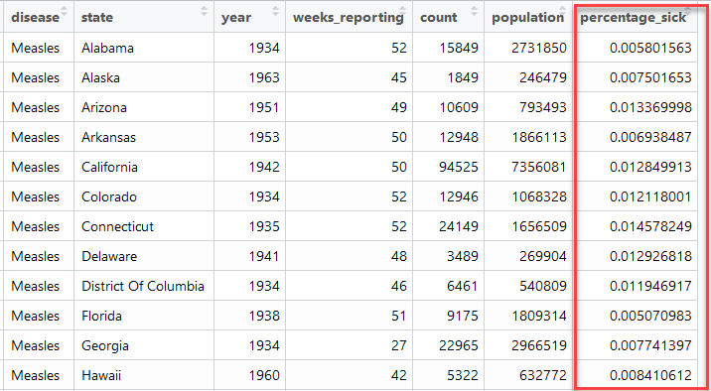
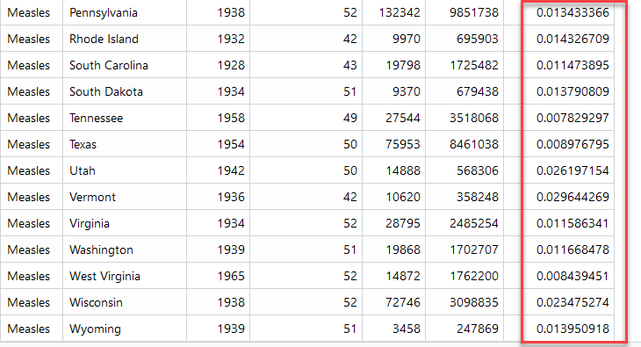
Finding Each State’s Highest Percentage of Being Sick

Slide 8
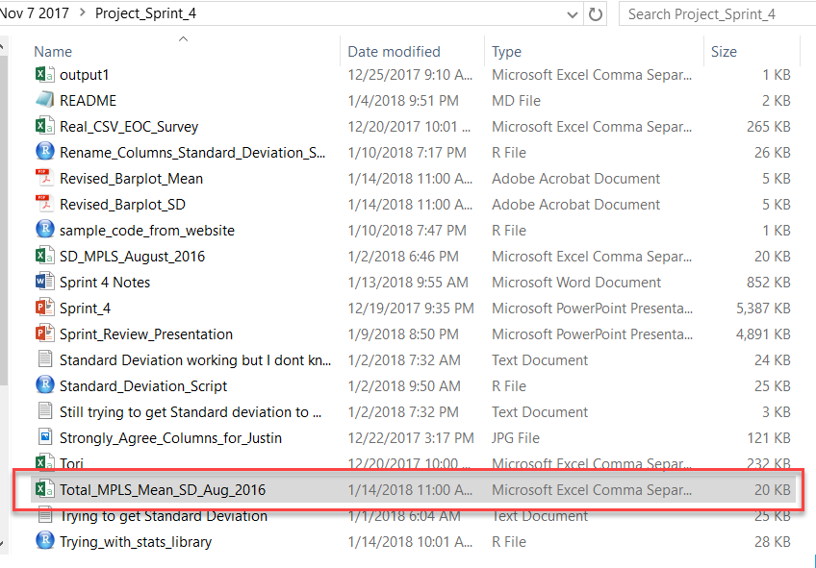

Write the R Completed Analysis Data Back to a CSV File
write.csv(Total_MPLS_Mean_SD_Aug_2016, "Total_MPLS_Mean_SD_Aug_2016.csv")

Slide 9
Thank you

